Slide 1

LEASEHOLDER FORUM
Major works:
clearer planning, fewer surprises
A constructive update on what leaseholders can expect, where Lewisham is now, and what is changing.
26 June

Slide 2
OPENING
What this session is here to do
“
To give a clear and honest picture of major works — and show the progress being made so leaseholders have better visibility, better explanations and a meaningful say.
These are reasonable expectations — and they are shaping how the service improves.
From feedback, complaints and wider guidance, five expectations come through consistently:
No surprises
Early notice of works and likely costs.
Clear explanation
Why works are needed and what they include.
Value for money
Confidence that costs are reasonable.
A meaningful say
Engagement beyond formal consultation.
Focus for tonight
Good delivery
Works done properly, with clear communication.
Leaseholder Forum · 26 June
02

Slide 3
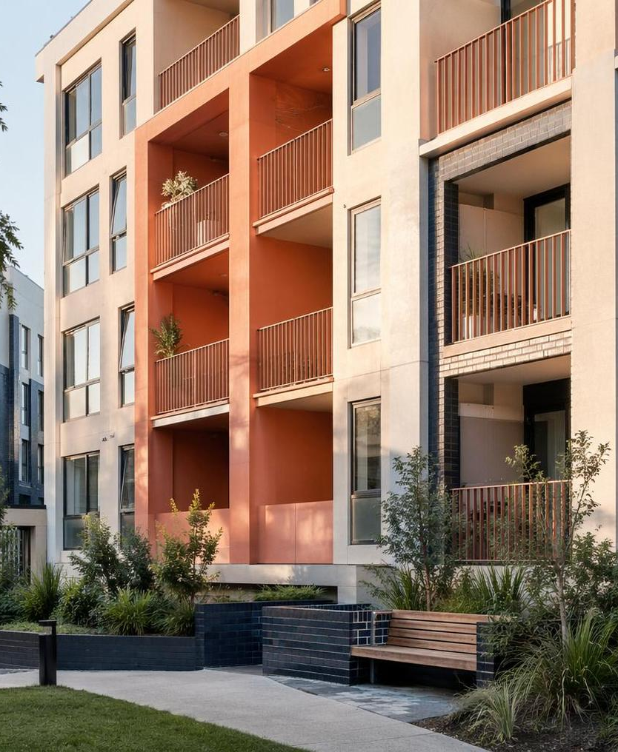
CURRENT POSITION
Building on strengths, closing the gaps
Lewisham is not starting from zero. The work now is to make planning and communication more consistent.
Important strengths
Areas to improve
Major works delivered at scale
Earlier visibility of works
Strong satisfaction when works are complete
Clearer scope and cost explanations
Commitment to safety and external condition
Consistent communication and planning
Focus: build on what works well and address the gaps.
Leaseholder Forum · 26 June
03

Slide 4
CONTEXT
Why major works are increasing
The programme is being driven by ageing buildings, stronger safety requirements and a shift toward longer-term asset management.
01
Ageing building fabric
02
Safety and compliance
03
Whole-building planning
Roofs, windows, façades and shared external elements are reaching renewal points.
Building safety, fire compliance and communal areas require continued investment.
More blocks need planned, block-level works rather than reactive repairs.
This means more planned, block-level major works and a move away from short-term reactive decisions.
Leaseholder Forum · 26 June
04

Slide 5

WHAT IS CHANGING
The improvement programme now underway
Asset Management Framework
Evidence-led decisions based on condition, risk and whole-building outcomes.
3–5-year visible pipeline
Earlier visibility so leaseholders can plan and fewer schemes feel unexpected.
Better building data
Stock updates, system integration and targeted surveys for complex blocks.
Stronger pre-start planning
Clearer scope, cost planning and specifications before works begin.
Diversified procurement
A broader contractor base matched to the right type of work.
Service organisation
Clearer accountability across planning, delivery and communication.
The common aim: clearer, more consistent decisions that are easier to explain.
Leaseholder Forum · 26 June
05

Slide 6
WHAT YOU SHOULD SEE
Clearer forward information, in stages
Some changes will be visible in the next year; others build as the new asset approach becomes embedded.
6–12
Earlier indication if your block is being considered
months
Improved communication on surveys and upcoming schemes
near term
Clearer explanation of what works involve and why
Medium term
A more stable, visible forward programme of works
Better alignment between condition, safety and investment decisions
Greater consistency in how schemes are delivered
Leaseholder Forum · 26 June
06

Slide 7

ONGOING PRIORITIES
What we will continue to improve
The new approach needs to translate into everyday experience: clearer plans, better explanations and evidence that feedback makes a difference.
1
Forward plans
Make plans clear, reliable and easier to track.
2
Cost and value
Explain costs and value for money more clearly.
3
Consistent communication
Reduce variation between schemes and stages.
4
Feedback loop
Show how leaseholder views influence decisions.
Leaseholder input remains essential as this approach is embedded.
Leaseholder Forum · 26 June
07

Slide 8
To conclude
The focus is a major works programme with fewer surprises and stronger communication.
Major works are increasing, but Lewisham is strengthening how works are planned, explained and delivered.
Fewer surprises
Clearer decisions
Earlier visibility of potential works
Better explanations of scope and need
Better planned works
Stronger communication
Stronger data, procurement and pre-construction
More consistency across schemes
Questions and discussion
Leaseholder Forum · 26 June

