Slide 1

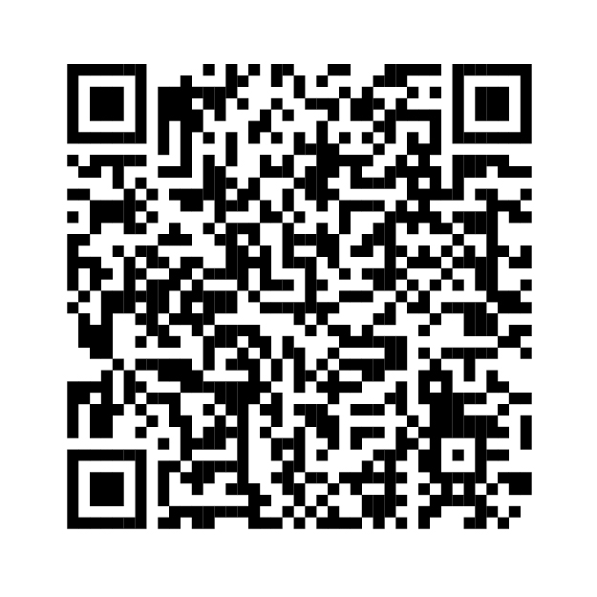
Arlington House 1 - 43 Information
Safety Features | Description
Fire doors | Communal fire doors are located within the Lift lobby area including bin chute locations on all residential floors to provide protection to residents should they need to exit in an emergency from smoke / fire in the event of an incident. There are also Communal fire doors located in residential corridors. These are periodically inspected and maintained. Flat entrance doors should provide 30 minutes Fire and smoke resistance and should be fitted with a self-closing device. This is monitored by the Building Safety team to ensure compliance with Fire / Building Safety legislation. There is a monitoring and maintenance programme in place.
Fire and smoke control equipment | There is a permanently openable venting (POV) system in place. Ventilation is provided via POV louvres to protected lobbies and at the top of the staircase.
Safety Features | Description
Evacuation information | You have a STAY PUT policy building.
Emergency lighting | Emergency lighting is provided in all communal areas and on escape routes within the building. This is periodically inspected and maintained.
Smoke detection | You should have a smoke/heat detection unit within your flat. If you do not, please contact your Building Safety Manager
Fire Escape Route | Your High-Rise residential building has one protected staircase with Fire Doors fitted onto the staircase
Your Building
Safety Manager is: Joseph Banton
Information available at lewisham.gov.uk/building-safety
Summary of your Safety Case
Relevant persons in relation to the higher-risk building
Resident engagement strategy
The procedure for making a complaint
Further information available on request
Further information on the Safety Case
Up to date fire risk assessments
Documents referenced in the Safety Case
Summary of any recent consultation
Taking into account the fire prevention measures observed at the time of the latest fire risk assessment, it is considered that the hazard from fire (likelihood of fire) at these premises is: Medium In this context, a definition of the above terms is as follows: Medium = Normal fire hazards (e.g. potential ignition sources) for this type of occupancy, with fire hazards generally subject to appropriate controls (other than minor shortcomings)
Telephone: 020 8314 6000
E:Buildingsafety@lewisham.gov.uk
If you would like to receive any of the information shown above please go to https://lewisham.gov.uk/myservices/housing/council-homes/building-safety/further-information-for-residents to fill out the Microsoft Form or email buildingsafety@lewisham.gov.uk stating your name, address and what information you would like to receive.

